Slide 1
Voice Controlled Robot Via Mobile App
Submitted by
GURRAM VENKATA PRAVEEN
(24NQ5A0402)
(praveenvenkatagurram402@gmail.com)
Electronics and Communication Engineering
Vikas College of Engineering and Technology

Slide 2
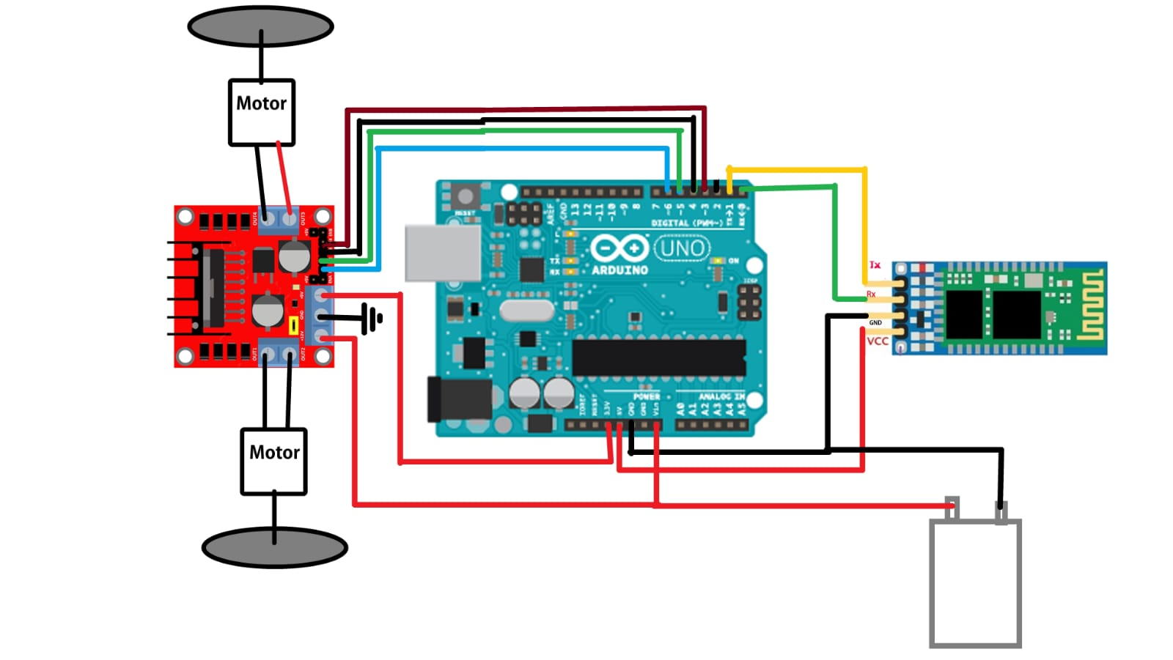
BO motor-1
Internal Block Diagram
Arduino Uno
L293D motor driver
HC-05 Bluetooth Control
9V
Battery
BO motor-2

Slide 3
START
Bluetooth Control Mobile Application
Fig.Flow Diagram
Bluetooth
ARDUINO ON CAR
Commands for the Robot
Forward
Backward
Left
Right
Stop
END
Movement of the Robot Car
L293D Motor Driver

Slide 4
Accuracy

Slide 5
Response Time
Time in (ms)
Commands

Slide 6
90%
90%
100%
Fig. Reliability Test

Slide 7
Motor Speed RPM
PWM Duty Cycle (%)

Slide 8
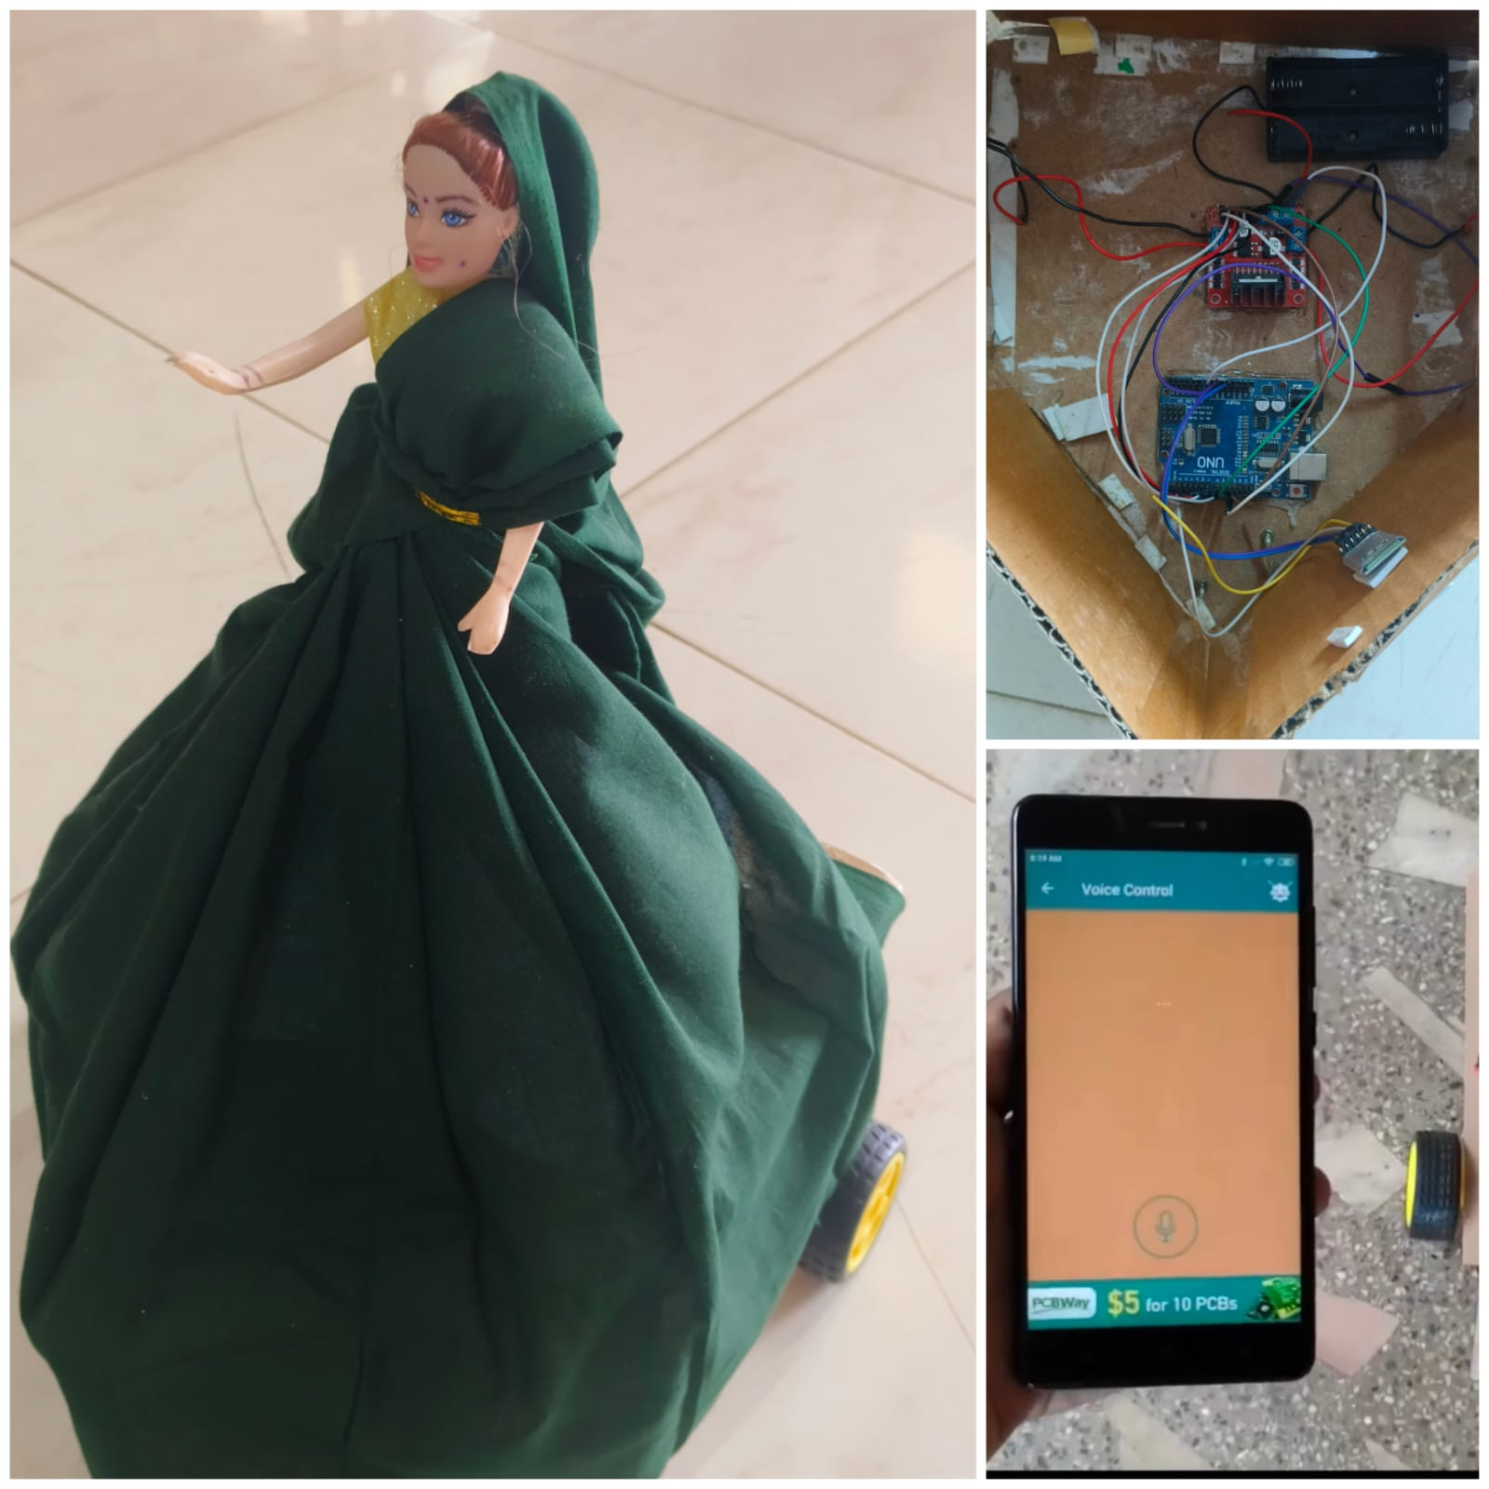

Slide 9
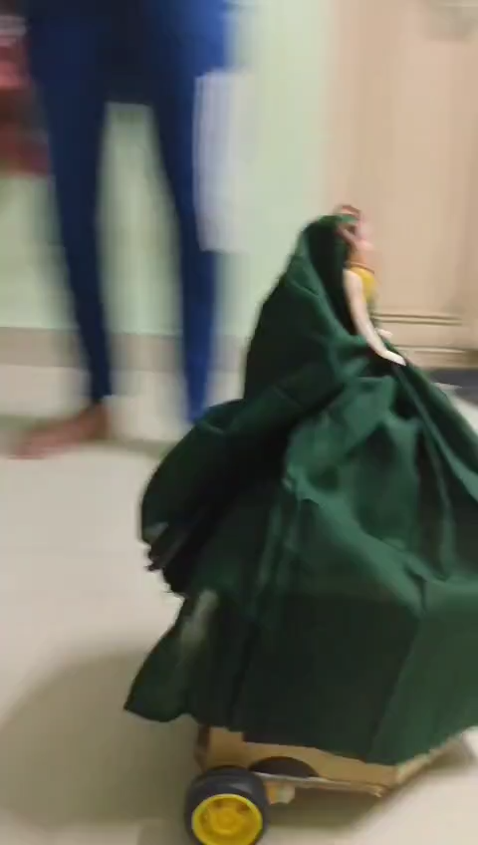
Moving of a Robot Based on The Given Voice Commands

Slide 10
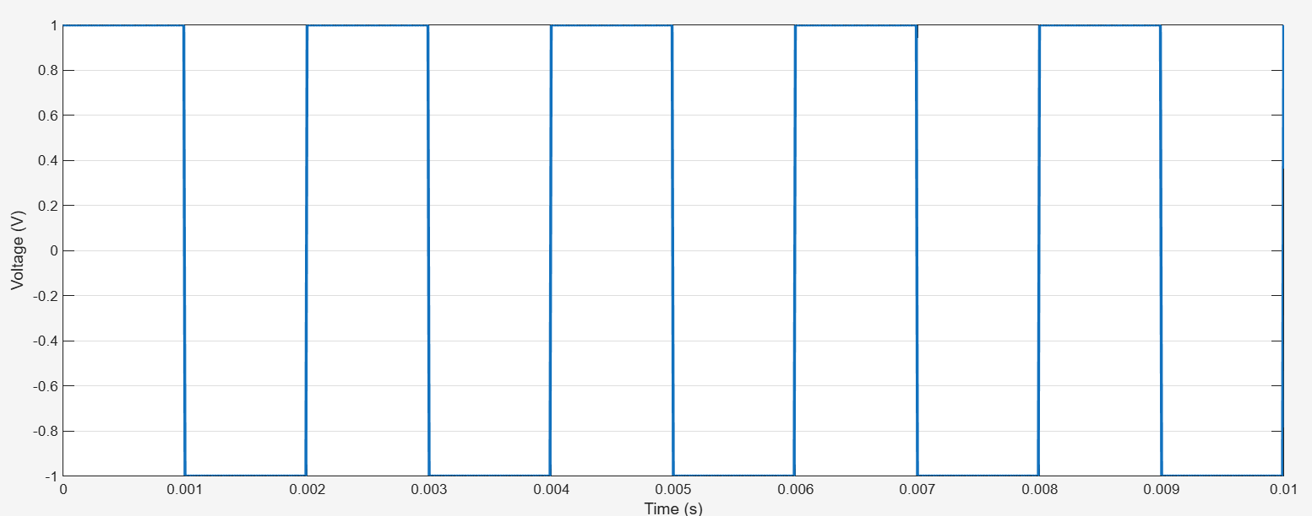
Output Waveform at HC-05 Bluetooth Control

Slide 11
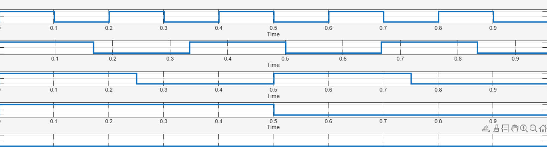
Output Waveforms
1
0.5
0
1
0.5
0
Logic Level
1
0.5
0
1
0.5
0
0.1
0.2
0.3
0.4
0.5
0.6
0.7
0.8
0.9
Time

Slide 12

Final Output of The Voice Controlled Robot
1.2
1
0.8
0.6
Digital Output Level
0.4
0.2
0
-0.2
0
0.5
1
1.5
2
2.5
3
3.5
4
4.5
5
Time (ms)

